Slide 1
Covid-19 disinformation: an African perspective
Herman Wasserman
University of Cape Town

Slide 2
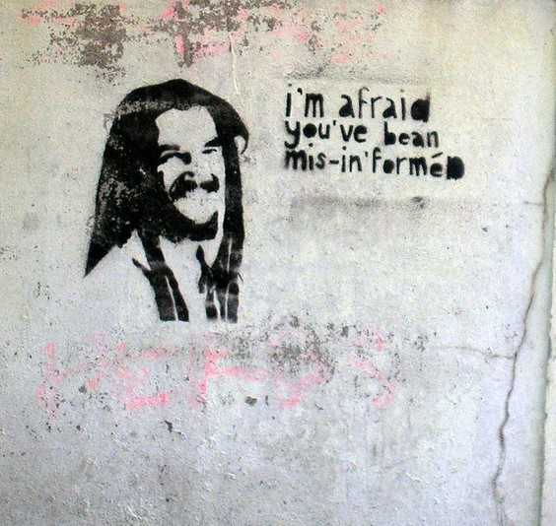
Overview
What is mis- and disinformation?
Some African examples in the context of Covid-19
Why and how does it spread?
How can we counter it?

Slide 3
Disinformation / ‘fake news’
Concerns about growing disinformation have become prevalent in discussions about the relationship between the media and politics in the Global North.
However, research shows that disinformation has grown rapidly in Africa, and that perceived exposure to false information even higher than in Global North
The ‘extraordinary’ amount of attention around truth, veracity and deception is related to its centrality in debates about the role of ‘fake news’ in the 2016 US presidential election.
Particularly, Donald Trump’s has weaponized the term ‘fake news’ to dismiss critics
UNESCO, in its handbook for journalists on the issue, adds:
“‘news’ means verifiable information in the public interest, and information that does not meet these standards does not deserve the label of news. In this sense then, ‘fake news’ is an oxymoron"

Slide 4
What is mis- and disinformation?
Unesco definitions:
Disinformation: Information that is false and deliberately created to harm a person, social group, organisation or country
Misinformation: Information that is false but not created with the intention of causing harm
Mal-information: Information that is based on reality, used to inflict harm on a person, social group, organisation or country.
Infodemic (WHO): overabundance of information – some accurate and some not – that makes it hard for people to find trustworthy sources and reliable guidance when they need it. In this situation, misinformation and rumors appear on the scene, along with manipulation of information with doubtful intent. In the information age, this phenomenon is amplified through social networks, spreading farther and faster like a virus.

Slide 5
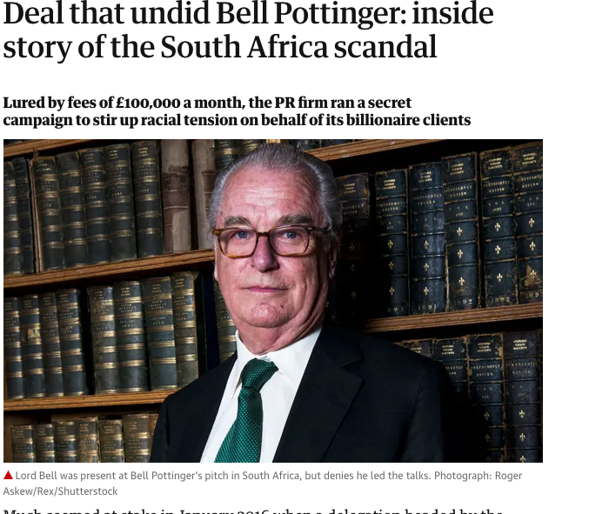
Disinformation in Africa
Like elsewhere in the Global South misinformation in Africa often takes form of extreme speech that incite violence or spread racist, misogynous, xenophobic messages
Mobile phone platforms such as Whatsapp - South Africa and Kenya
Misinformation campaigns – Bell Pottinger #wmc (SA)
Concerns about election inference
Governments respond strongly, e.g. internet shutdowns, criminalization – concerns for freedom of expression
Worsened by Covid-pandemic

Slide 6
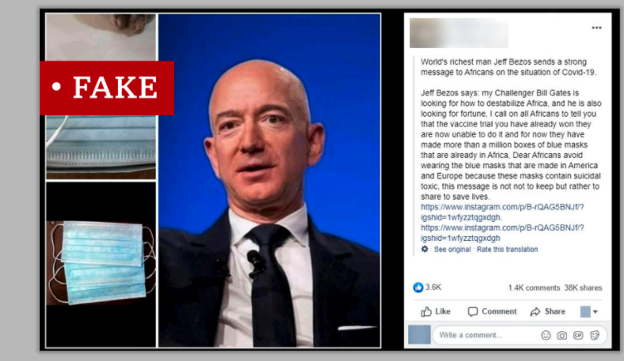
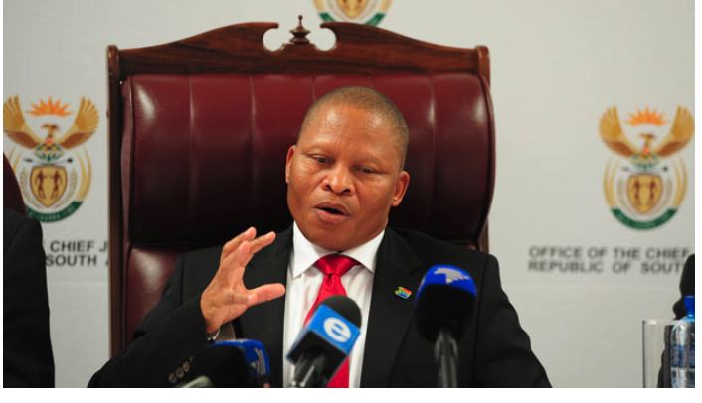
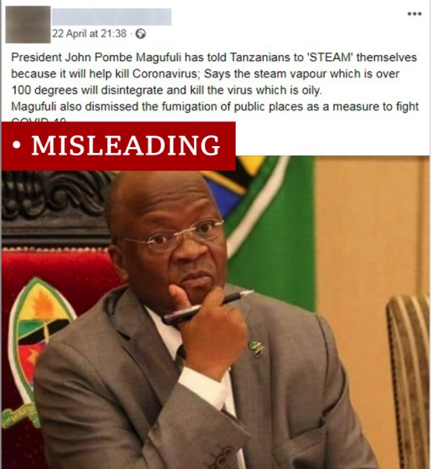
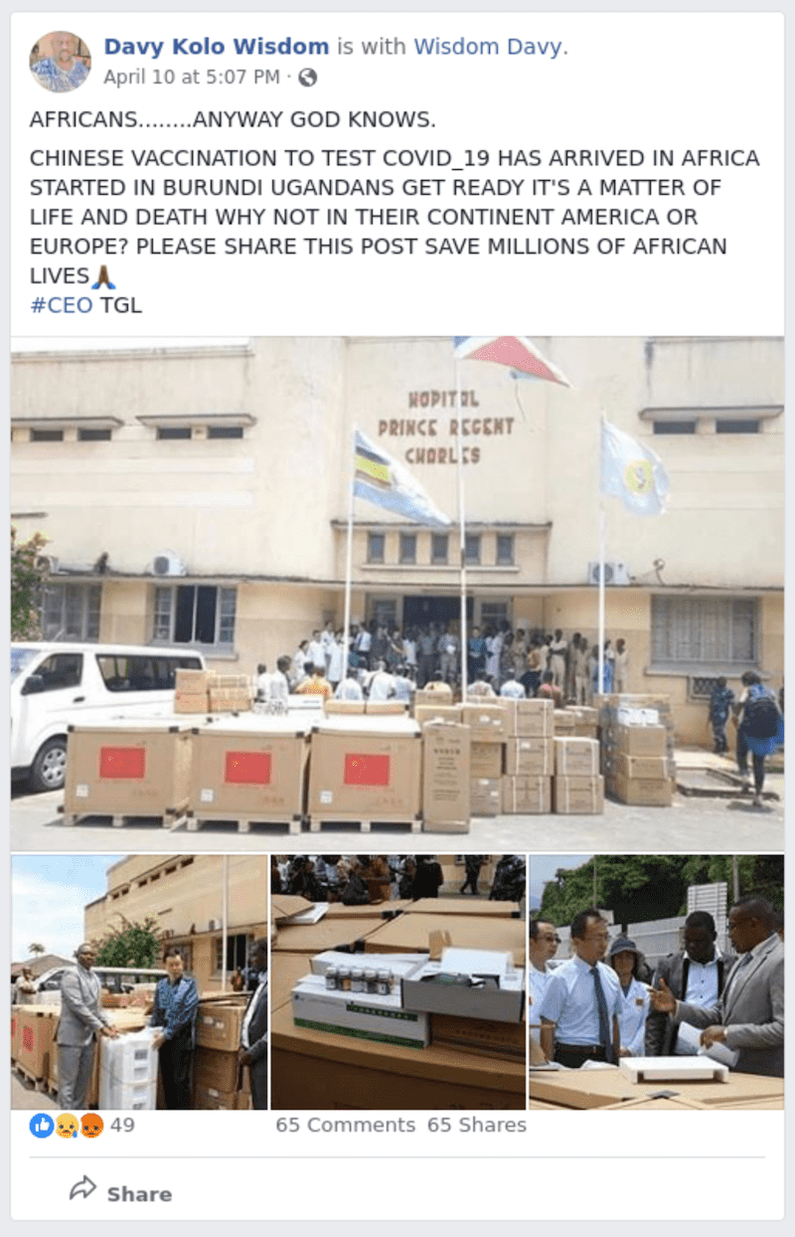
Covid-19 examples
Some examples of Covid-19 disinformation:
Late pres. Magafuli said steam kills the virus
Contaminated facemasks to ‘destabilize Africa’
Anti-vaxx disinformation:
Videos warning people about ‘Bill Gates vaccines’ to be tested in Africa, ‘change your DNA’, CNN logo ‘Penis injection hoax’
Social media platform design encouraging quick scrolling, inaccurate reading
Amplified by people in power
“If there be any [COVID-19] vaccine that is the work of the devil meant to infuse 666 in the lives of the people, meant to corrupt their DNA … may it be destroyed by fire.” South Africa’s chief justice, Mogoeng Mogoeng

Slide 7
Disinformation, journalism and context
Journalism as an institution cannot hope to control the new communication environment - rise of a chaotic, fragmented and widely dispersed new public communication order.
Rise of false information is rooted in more complex cultural and social shifts articulated through major shifts in communication practices and infrastructures
Therefore - attempt to curb the spread of false information by embarking on zealous media literacy campaigns is too limited response to deal with the complex challenge (Waisbord 2018)

Slide 8
Why and how do mis- and disinformation spread?
For false news to make an impact, it has to be shared. Why do people consume and share?
Feeds on anxieties, stereotypes, uncertainty, bias – if people do not know who to trust or where to get accurate information, disinformation has a foothold
Social context, view of authority, trust in media – all important factors
Study of motivations within context important step in countering disinformation
WHO guidance : Formal research e.g. surveys, also social media listening and analysis – understand rumours, conspiracy theories, perceptions and motivations towards vaccines

Slide 9
Why and how does mis- and disinformation spread?
Example:
Previous research of African media users:
high likelihood to share misinformation, even knowingly
users employ variety of cues to determine veracity (agency)
motivations to share depends on topic (e.g to duty to warn others ‘just in case’, or ‘for fun’)
the political use of humour plays an important role – history of alternative communication forms (‘pavement radio’) in contexts of repression, state control of media

Slide 10
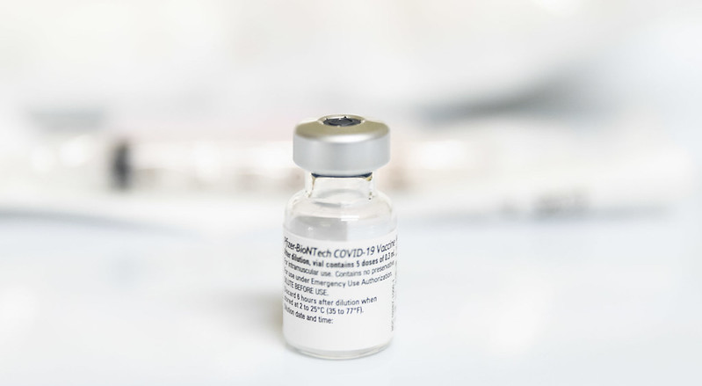
How do we counter it?
Different types of responses:
Identification responses (debunking, fact-checking, investigative)
Aimed at production and distribution environment (legislative – e.g. criminalization, policy, counter-disinfo campaigns)
Aimed at production and distribution mechanisms (curatorial, algorithmic, demonetization, e.g. accuracy check reminders, label inaccurate or disputed claims, stop searches for ‘vaccines’)
Aimed at target audience rather than denier (ethical, educational, empowerment ): Technique rebuttal identifying common and “topic rebuttal” (attack plausibility of disinformation with facts)
Context-specific, not ‘inoculation’ that works the same everywhere

Slide 11
How do we counter it?
Establish motivations, causes, perceptions: surveys, social media listening, qualitative work, social media network analysis to establish influencers
Appeal to dominant motivations:
E.g. civic responsibility - enlist help to spread correct information, show dangers of amplifying misinformation.
‘Fun’, gamify, develop memes etc

Slide 12
How do we counter it?
Not top-down, one-directional communication – esp when people already are skeptical of authority.
Avoid shaming or driving people deeper into their ‘echo chambers’
Create spaces for dialogue, discussion, Q&A
Engage civil society, faith communities, family networks or groups
Uphold freedom of expression
Counter bad information with good information – but establish efficacy within context (issues of trust, access, mode of delivery)

Slide 13
Further reading
Articles:
https://theconversation.com/study-sheds-light-on-scourge-of-fake-news-in-africa-106946
A recent study by the UK-based Reuters Institute on types of Covid-19 Misinformation
Fact-checking organisations and sites:
First Draft News
Africa Check
Digital Forensics Research Lab

